Slide 1
ICT-LEARNFACTORY
Multi-User-Applikationen
objektorientiert realisieren
Unit Testing und TDD
08/16/26
Notes:
[Sources]
- Redesign follows the supplied ICT-LearnFactory Brand Guide (Aptos typography; Charcoal Flux #272726, Hyper Teal #45D9C7, Lumen Zest #D9EB12, Abyss Teal #29948C; geometric brand-mark pattern language).
- Slide content is preserved from the uploaded source presentation 04_Unit-Testing-TDD.odp.
[/Sources]

Slide 2
Handlungsnotwendige Kenntnisse
4.1 Kennt relevante Aspekte, welche bei der Testspezifikation einer Muli-User-Applikation zu berücksichtigen sind.
4.2 Kennt ein Vorgehen, um nicht-funktionale Anforderungen zu testen.
ICT-LEARNFACTORY
Unit Testing TDD
Notes:
[Sources]
- Redesign follows the supplied ICT-LearnFactory Brand Guide (Aptos typography; Charcoal Flux #272726, Hyper Teal #45D9C7, Lumen Zest #D9EB12, Abyss Teal #29948C; geometric brand-mark pattern language).
- Slide content is preserved from the uploaded source presentation 04_Unit-Testing-TDD.odp.
[/Sources]

Slide 3
Ziele
Du erinnerst dich an die verschiedenen Testarten.
Du erinnerst dich an die Prinzipien des Unit-Testing.
Du weisst, was Test Driven Development (TDD) ist.
ICT-LEARNFACTORY
Unit Testing TDD
Notes:
[Sources]
- Redesign follows the supplied ICT-LearnFactory Brand Guide (Aptos typography; Charcoal Flux #272726, Hyper Teal #45D9C7, Lumen Zest #D9EB12, Abyss Teal #29948C; geometric brand-mark pattern language).
- Slide content is preserved from the uploaded source presentation 04_Unit-Testing-TDD.odp.
[/Sources]

Slide 4
Testing
Refresher
An deine Webapplikation wurden Anforderungen gestellt …
Funktionalitäten
Geschwindigkeit
Benutzerfreundlichkeit
Sicherheit …
… diese Anforderungen müssen geprüft werden!
Je später Fehler entdeckt werden, desto aufwändiger (teurer) ist ihre Behebung
Tests die häufig wiederholt werden, sollten automatisiert werden
ICT-LEARNFACTORY
Unit Testing TDD
Notes:
[Sources]
- Redesign follows the supplied ICT-LearnFactory Brand Guide (Aptos typography; Charcoal Flux #272726, Hyper Teal #45D9C7, Lumen Zest #D9EB12, Abyss Teal #29948C; geometric brand-mark pattern language).
- Slide content is preserved from the uploaded source presentation 04_Unit-Testing-TDD.odp.
[/Sources]

Slide 5
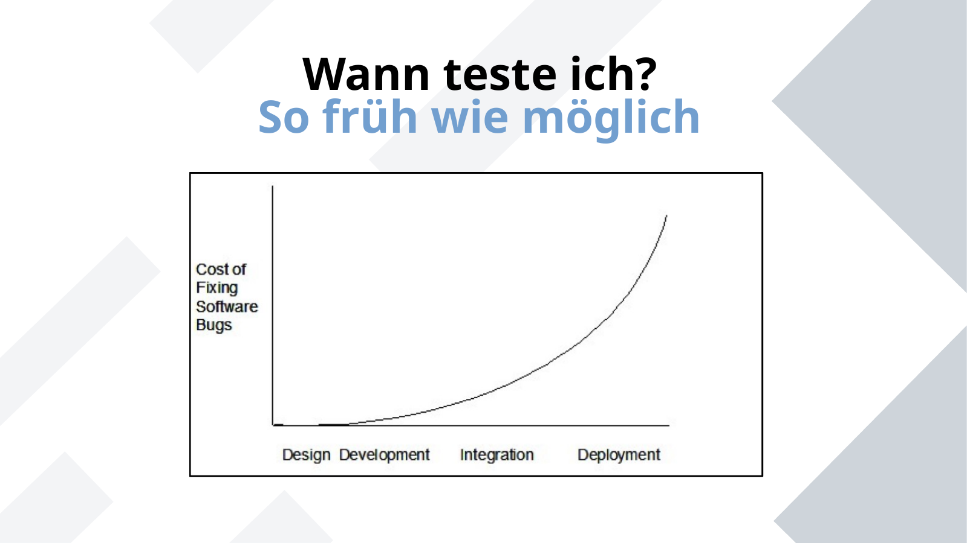
Wann teste ich?
So früh wie möglich
ICT-LEARNFACTORY
Unit Testing TDD
Notes:
[Sources]
- Redesign follows the supplied ICT-LearnFactory Brand Guide (Aptos typography; Charcoal Flux #272726, Hyper Teal #45D9C7, Lumen Zest #D9EB12, Abyss Teal #29948C; geometric brand-mark pattern language).
- Slide content is preserved from the uploaded source presentation 04_Unit-Testing-TDD.odp.
[/Sources]

Slide 6
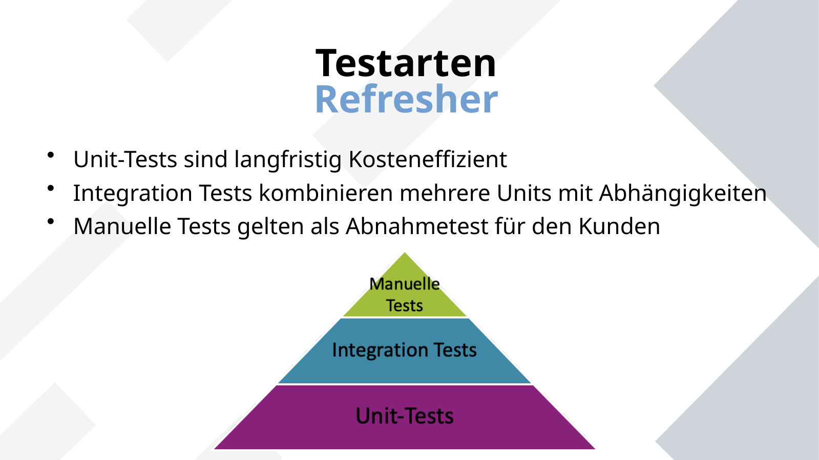
Testarten
Refresher
Unit-Tests sind langfristig Kosteneffizient
Integration Tests kombinieren mehrere Units mit Abhängigkeiten
Manuelle Tests gelten als Abnahmetest für den Kunden
ICT-LEARNFACTORY
Unit Testing TDD
Notes:
[Sources]
- Redesign follows the supplied ICT-LearnFactory Brand Guide (Aptos typography; Charcoal Flux #272726, Hyper Teal #45D9C7, Lumen Zest #D9EB12, Abyss Teal #29948C; geometric brand-mark pattern language).
- Slide content is preserved from the uploaded source presentation 04_Unit-Testing-TDD.odp.
[/Sources]

Slide 7
Unit-Tests
FIRST
Zweck: Automatisiertes Testen von einzelnen Methoden ohne Abhängigkeiten
ICT-LEARNFACTORY
Unit Testing TDD
Notes:
[Sources]
- Redesign follows the supplied ICT-LearnFactory Brand Guide (Aptos typography; Charcoal Flux #272726, Hyper Teal #45D9C7, Lumen Zest #D9EB12, Abyss Teal #29948C; geometric brand-mark pattern language).
- Slide content is preserved from the uploaded source presentation 04_Unit-Testing-TDD.odp.
[/Sources]

Slide 8
Test Driven Development (TDD)
Bestandteil von verschiedenen agilen Entwicklungsmethoden.
Tests vor Logik
Bessere Konzeption des Codes
Tests werden nicht aussen vorgelassen
Höhere Wartbarkeit
ICT-LEARNFACTORY
Unit Testing TDD
Notes:
[Sources]
- Redesign follows the supplied ICT-LearnFactory Brand Guide (Aptos typography; Charcoal Flux #272726, Hyper Teal #45D9C7, Lumen Zest #D9EB12, Abyss Teal #29948C; geometric brand-mark pattern language).
- Slide content is preserved from the uploaded source presentation 04_Unit-Testing-TDD.odp.
[/Sources]

Slide 9
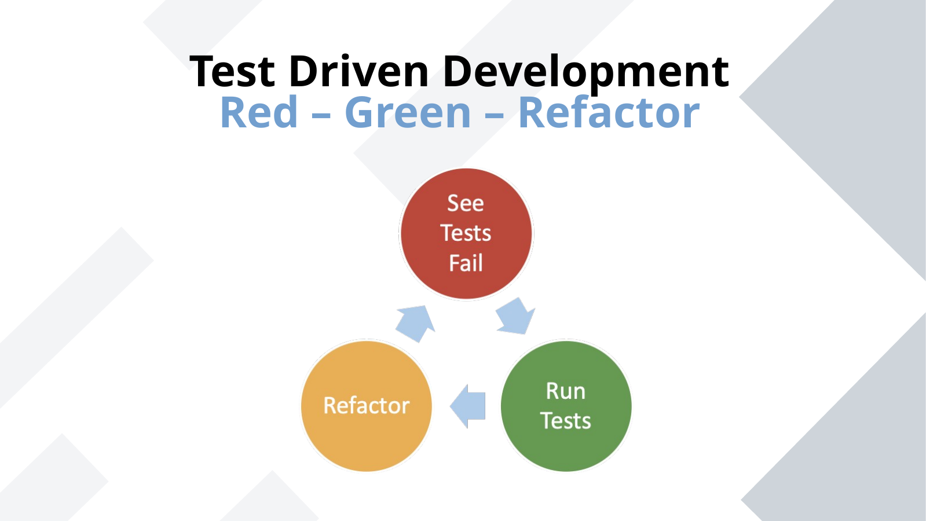
Test Driven Development
Red – Green – Refactor
ICT-LEARNFACTORY
Unit Testing TDD
Notes:
[Sources]
- Redesign follows the supplied ICT-LearnFactory Brand Guide (Aptos typography; Charcoal Flux #272726, Hyper Teal #45D9C7, Lumen Zest #D9EB12, Abyss Teal #29948C; geometric brand-mark pattern language).
- Slide content is preserved from the uploaded source presentation 04_Unit-Testing-TDD.odp.
[/Sources]

Slide 10
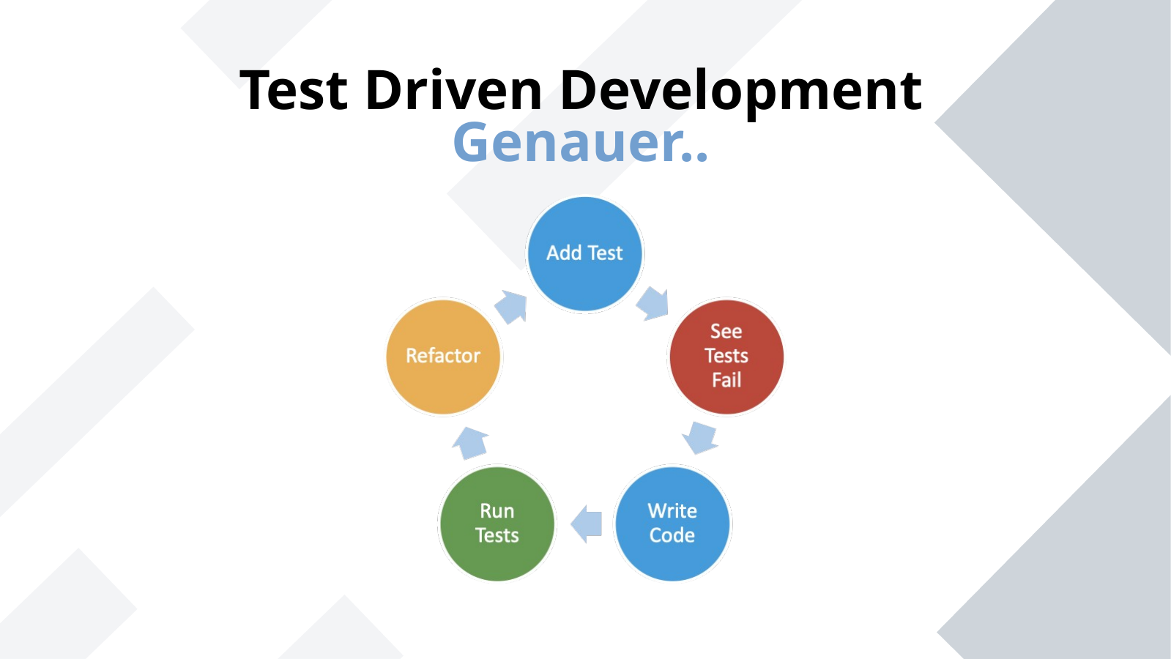
Test Driven Development
Genauer..
ICT-LEARNFACTORY
Unit Testing TDD
Notes:
[Sources]
- Redesign follows the supplied ICT-LearnFactory Brand Guide (Aptos typography; Charcoal Flux #272726, Hyper Teal #45D9C7, Lumen Zest #D9EB12, Abyss Teal #29948C; geometric brand-mark pattern language).
- Slide content is preserved from the uploaded source presentation 04_Unit-Testing-TDD.odp.
[/Sources]

Slide 11
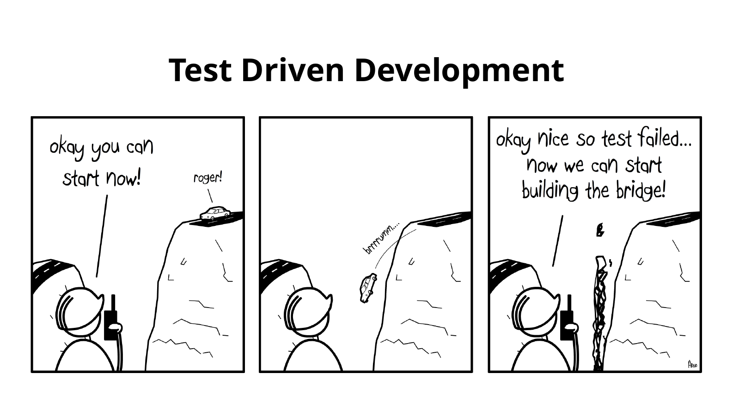
Test Driven Development
ICT-LEARNFACTORY
Unit Testing TDD
Notes:
[Sources]
- Redesign follows the supplied ICT-LearnFactory Brand Guide (Aptos typography; Charcoal Flux #272726, Hyper Teal #45D9C7, Lumen Zest #D9EB12, Abyss Teal #29948C; geometric brand-mark pattern language).
- Slide content is preserved from the uploaded source presentation 04_Unit-Testing-TDD.odp.
[/Sources]

Slide 12
Fragen?
ICT-LEARNFACTORY
Unit Testing TDD
Notes:
[Sources]
- Redesign follows the supplied ICT-LearnFactory Brand Guide (Aptos typography; Charcoal Flux #272726, Hyper Teal #45D9C7, Lumen Zest #D9EB12, Abyss Teal #29948C; geometric brand-mark pattern language).
- Slide content is preserved from the uploaded source presentation 04_Unit-Testing-TDD.odp.
[/Sources]

